Slide 1
Integrating the System

Slide 2
Build System
The automation of these build processes is crucial for achieving continuous integration (CI) and continuous delivery (CD).
Software building is the process of molding code from one form to another

Slide 3
Building code in the context of DevOps serves several crucial purposes:
Compilation: The source code is compiled into executable code or bytecode that can run on the intended environment.
Linting: Checking the code for errors and generating code quality measures by means of static code analysis.
Unit Testing:This involves running controlled tests on small, isolated parts of the codebase (units) to ensure they function correctly in isolation.
Artifact Generation: Once the code has been compiled, linted, and tested, artifacts are generated. These artifacts are the output of the build process and are typically executable binaries, libraries, configuration files, documentation, or any other files required for deployment.

Slide 4
Build tools
For Java, there is Maven, Gradle, and Ant
For C and C++, there is Make in many different flavors
For Clojure, a language on the JVM, there is Leiningen and Boot apart from Maven
For JavaScript, there is Grunt
For Scala, there is sbt
For Ruby, we have Rake

Slide 5
The Jenkins build server
Jenkins is a widely-used open-source automation server that helps automate the software development process, including building, testing, and deploying applications.
It supports a wide range of plugins to extend its functionality and integrates with various tools and technologies.
Starting Jenkins: sudo systemctl start Jenkins
Accessing Jenkins:By default, Jenkins runs on port 8080. You can access the Jenkins web interface using your server's IP address or domain name followed by port 8080

Slide 6
Install Plugins: Install any additional plugins needed for your Java project, such as Git plugin for version control integration, Maven or Gradle plugin for build tools support, and any testing plugins.
Create a New Jenkins Job (Pipeline)
Create New Item: From the Jenkins dashboard, click on "New Item" to create a new job.
Enter Job details: Provide a name of your job. Select pipeline as the job and click ok.

Slide 7
Configure Jenkins Pipeline
Pipeline Script: In the job configuration page, scroll down to the Pipeline section.
Pipeline Definition: Choose whether to define the pipeline script directly in Jenkins or from a source code repository (e.g., Jenkinsfile in Git).
Save and Build
Save Pipeline: Save your pipeline configuration.
Build: Click on "Build Now" to trigger a build of your Java project.

Slide 8
Monitor Build Progress and Results
Build Console Output: View the detailed console output to monitor the build progress and see any errors or warnings.
Build History: Navigate to the job dashboard to see the build history, including previous build results.

Slide 9
Managing build dependencies
A dependency refers to a software component, module, library, or package that a particular piece of software relies on to function correctly.
Managing build dependencies is a critical aspect of setting up a build environment, especially in a Continuous Integration (CI) server like Jenkins.

Slide 10
Dependency Management: Maven (Java Builds)
Maven projects uses POM(project object model) to define dependencies.
To include a dependency, you specify it in the pom.xml
<dependencies>
<dependency>
<groupId>org.springframework</groupId>
<artifactId>spring-core</artifactId>
<version>5.3.7</version>
</dependency>
</dependencies>

Slide 11
Grunt (JavaScript Builds)
Build Description: Grunt uses a package.json file to define dependencies and build tasks. Dependencies are managed using npm (Node Package Manager) and are installed automatically based on the package.json.
Example: Dependencies listed in package.json

Slide 12
The final artifact
The final output from a Maven build is usually an enterprise archive, or EAR file for short.
let's consider the deployment of a Java EAR. Normally, we can do this in several ways.
Here are some examples:
• Deploy the EAR file as an RPM package through the mechanisms and channels available in the base operating system
• Deploy the EAR through the mechanisms available with the Java application server, such as JBoss, WildFly, and Glassfish

Slide 13
Using docker
Start by creating a Docker image that includes the necessary runtime environment for your Java application, such as JDK, application server (e.g., JBoss, WildFly, or Glassfish), and any other dependencies.
# Use a base image with Java and WildFly installed
FROM jboss/wildfly:latest
# Copy the EAR file into the deployments directory of WildFly
COPY your-app.ear /opt/jboss/wildfly/standalone/deployments/

Slide 14
Continuous Integration
Continuous Integration (CI) is a software development practice where developers regularly merge their code changes into a central repository.
Each merge triggers an automated build process that includes compiling the code, running automated tests, and often deploying the application or its components to a test environment.
The goal of CI is to detect integration issues early and ensure that the software remains in a deployable state at all times.

Slide 15
CI/CD
A CI/CD pipeline is a sequence of steps (build, test, deploy) that automates the process of delivering software changes from version control to production.
Checkout: Fetching the latest code from version control.
Build: Compiling the code into executable artifacts.
Test: Running automated tests to validate functionality and quality.
Deploy: Deploying the application to a staging or production environment

Slide 16
CI/CD
Automated Builds
Automated Testing
Continuous Deployment
Version Control Integration

Slide 17
Continuous Delivery
Continuous Integration steps have completed successfully, you have shiny new artifacts that are ready to be deployed to servers.
The deployment servers take over the responsibility of deploying them to the application servers.

Slide 18
Jenkins plugins
Jenkins has a plugin system to add functionality to the build server.
Git Plugin: Integrates Jenkins with Git repositories, allowing Jenkins to clone, fetch, and push changes.
GitHub Plugin: Provides additional integration features specific to GitHub repositories, such as GitHub pull request builder.
Maven Integration Plugin: Facilitates building Java projects using Apache Maven, handling dependencies and project lifecycles.
Gradle Plugin: Supports building projects using Gradle build tool, managing dependencies and tasks.

Slide 19
JUnit Plugin: Integrates JUnit testing framework with Jenkins, providing test result reporting and trend analysis.
Cucumber Plugin: Supports Cucumber BDD (Behavior-Driven Development) framework for automated acceptance testing.

Slide 20
Triggers
Jenkins Build Triggers trigger the build of the project for continuous integration and continuous deployment.
You can see the build triggers option in job's -> Configure setting.

Slide 21
Jenkins build triggers
Trigger builds remotely
Build after other projects are built
Build periodically
GitHub hook trigger for GITScm polling
Poll SCM

Slide 22
Trigger builds remotely
If you want to trigger your project built from anywhere anytime then you should select Trigger builds remotely option from the build triggers.
You’ll need to provide an authorization token in the form of a string so that only those who know it would be able to remotely trigger this project’s builds.

Slide 23
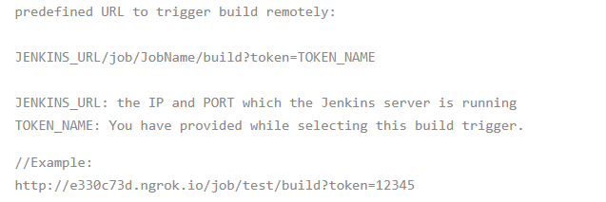

Slide 24
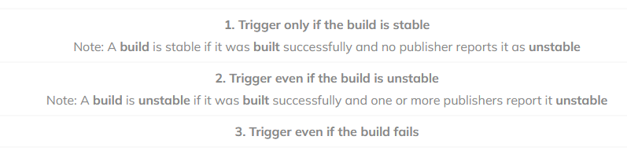
Build after other projects are built
If your project depends on another project build then you should select Build after other projects are built option from the build triggers.
you must specify the project(Job) names in the Projects to watch field section and select one of the following options:

Slide 25
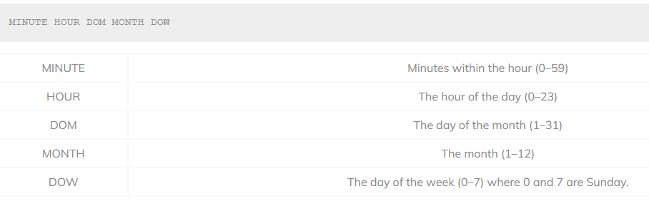
Build periodically
If you want to schedule your project build periodically then you should select the Build periodically option from the build triggers.
You must specify the periodical duration of the project build in the scheduler field section

Slide 26
GitHub webhook trigger for GITScm polling
A webhook is an HTTP callback, an HTTP POST that occurs when something happens through a simple event-notification via HTTP POST.
GitHub webhooks in Jenkins are used to trigger the build whenever a developer commits something to the branch.

Slide 27
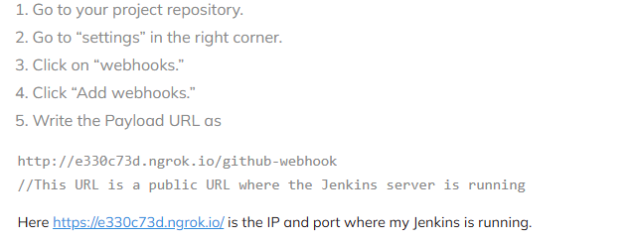
To add build a webhook in GitHub and then add this webhook in Jenkins.

Slide 28
Poll SCM
Poll SCM periodically polls the SCM to check whether changes were made (i.e. new commits) and builds the project if new commits were pushed since the last build.
You must schedule the polling duration in the scheduler field.
After successfully scheduled, the scheduler polls the SCM according to your specified duration in scheduler field and builds the project if new commits were pushed since the last build.

Slide 29
Build servers and infrastructure as code
The disparity between GUI-based tools like Jenkins and the principle in DevOps that infrastructure should be defined as code.
Impedance Mismatch: Jenkins, GUI-driven, meaning its configuration and job definitions are primarily managed through its web interface.
While job descriptors can be stored as text files (e.g., Jenkinsfiles), modifying them directly via the web UI is more common.
This contrasts with the DevOps principle of defining infrastructure and processes as code.

Slide 30

Building by dependency order
Many build tools have the concept of a build tree where dependencies are built in the order required for the build to complete, since parts of the build might depend on other parts.

Slide 31
Alternative build servers
Travis CI:
Description: Travis CI is a hosted CI/CD service that is particularly popular among open source projects. It integrates seamlessly with GitHub and Bitbucket repositories.
Key Features: Supports automatic testing and deployment for GitHub and Bitbucket projects, YAML-based configuration, and a scalable cloud-based infrastructure.
Advantages: Easy setup for open source projects, good integration with version control systems, and a straightforward YAML configuration for pipelines.

Slide 32
Buildbot:
Description: Buildbot is an open-source CI/CD framework written in Python. It offers flexibility and configurability, allowing users to define build processes through Python scripts.
Key Features: Highly customizable, supports distributed builds, and integrates well with various version control systems and notification mechanisms.
Advantages: Ideal for teams needing deep customization and control over their build processes, particularly those comfortable with Python scripting.

Slide 33
GitLab CI/CD:
Description: GitLab offers built-in CI/CD capabilities as part of its integrated DevOps platform. It uses .gitlab-ci.yml files for defining pipelines, emphasizing infrastructure as code principles.
Key Features: Provides end-to-end DevOps capabilities within a single platform, including version control, issue tracking, CI/CD, and more.
Advantages: Offers tight integration with GitLab’s version control system, enabling seamless workflows from code changes to deployment.

